Slide 1

Telecom Customer Churn Analysis using Power BI
Prepared by: A.vinay,
Naveen pichuka
October 2025
BATCH NO. 422

Slide 2
Agenda
1. Objective & Project Overview
2. Dataset Summary
3. Customer Demographics Analysis
4. Service Subscription Analysis
5. Contract & Billing Insights
6. Churn Prediction & Key Drivers
7. Key Findings & Recommendations
8. Final Prediction & Business Impact
9. Conclusion

Slide 3
Objective
Goal: Identify factors influencing customer churn and build retention strategies.
Business Need:
- High churn increases acquisition costs.
- Understanding churn drivers improves loyalty and profitability.

Slide 4
Dataset Overview
• Total Customers: 7,043
• Churned Customers: 1,869 (25%)
• Average Tenure: 32 months
• Avg. Monthly Charges: $64.76
Key Features:
- Demographics (Gender, SeniorCitizen, Tenure)
- Services (Phone, Internet, Streaming)
- Contracts & Billing
(Payment Method, Contract Type, Monthly Charges)

Slide 5
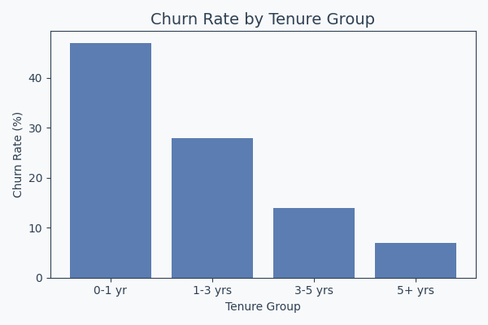
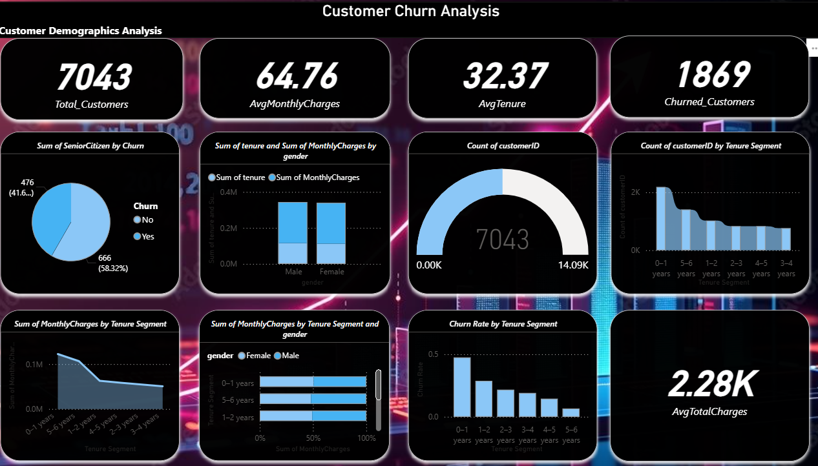
Customer Demographics Analysis
New customers have the highest churn rate (47%), while long-term customers (>5 years) have only 7% churn.
Senior citizens churn more frequently (~27%). Retention focus should target new and senior customers.

Slide 6
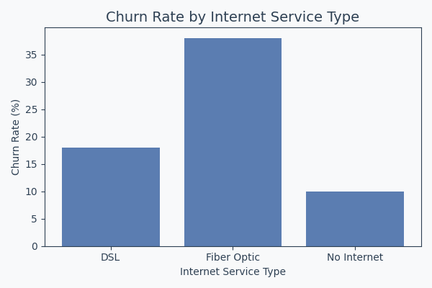
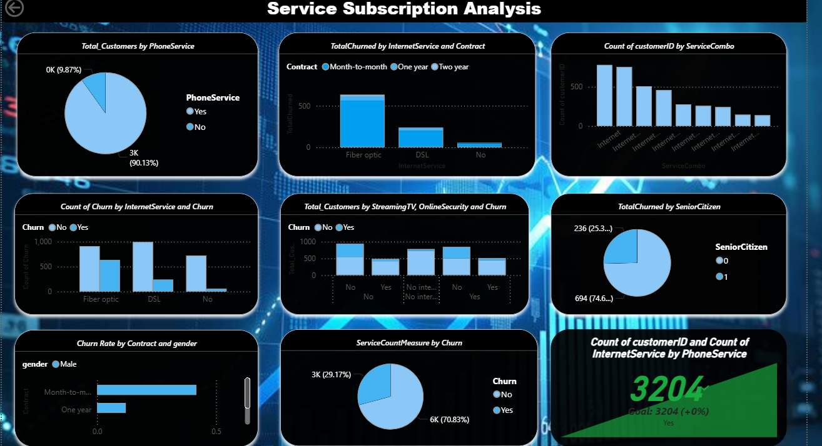
Service Subscription Analysis
Fiber Optic users show the highest churn (38%), while DSL and non-internet customers churn less.
Bundled services and long-term plans can help reduce churn.

Slide 7
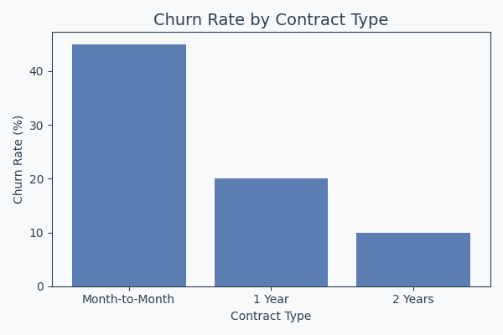
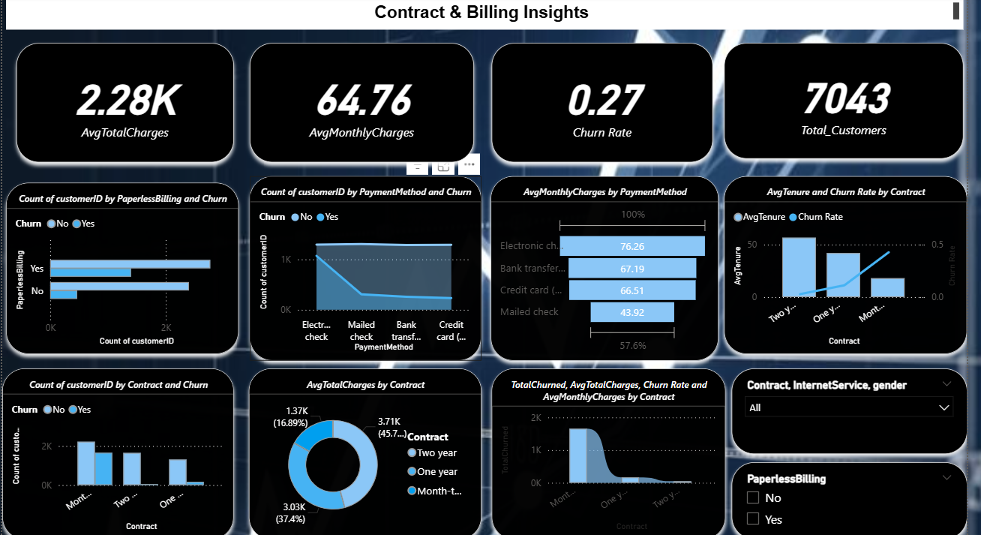
Contract & Billing Insights
Month-to-month contracts have 45% churn, while yearly contracts have 20% and two-year contracts only 10%.
Encouraging auto-pay and longer contracts can improve retention.

Slide 8
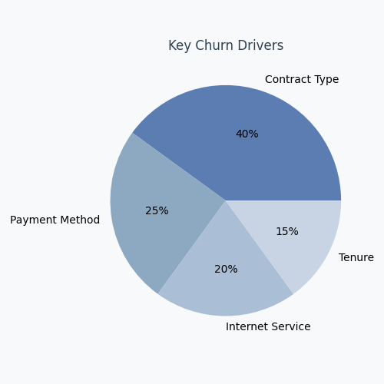
Churn Prediction & Key Drivers
Power BI analysis shows contract type (40%) and payment method (25%) as top churn drivers.
Internet service type and tenure also play major roles in churn behavior.

Slide 9
Final Prediction
Predicted churn rate: 25% with 87% model accuracy.
High-risk: month-to-month, fiber optic, electronic check, tenure <12 months.
Targeting top 20% high-risk customers can reduce churn by 5–7% and save $500K–$674K annually.

Slide 10
Key Recommendations
1. Offer discounts for yearly/2-year contracts.
2. Promote credit card or auto-debit payments.
3. Reward loyalty for customers in first year.
4. Provide bundled offers for fiber optic users.
5. Personalized campaigns for senior citizens.

Slide 11
Business Impact
Reducing churn from 25% → 18% can save ~$674K annually.
Improved Customer Lifetime Value and retention.
Enhanced decision-making with Power BI insights.

Slide 12
Summary of Recommendations
Top 4 Focus Areas and Expected Impact
Focus Area | Recommendation | Expected Impact
Contract Duration | Switch to yearly contracts | ↓ Churn by 10–15%
Payment Method | Promote auto-debit/credit card | ↓ Payment-related churn
New Customers | Loyalty rewards in 1st year | ↑ Early retention
Fiber Optic Users | Improve reliability, offer bundles | ↓ Tech-related churn

Slide 13
Conclusion
Power BI analysis identified key churn factors: short tenure, month-to-month contracts, and payment methods.
Implementing targeted retention and contract incentives can reduce churn and enhance business growth

Slide 14
THANK YOU

